Slide 1

Project PROMetheus
Vision, Architecture and Predictive Analytics

Slide 2
Purpose
Introduce our Front End R&D group
Surgical technologies
Right Information…right time…right place
Overview of our Proof of Concept
Internet of Things
Machine Learning
Request connection to TruView and other assets to JnJ Enterprise Cloud
HealthPartners, TruMatch, Intra-operative smart tools
Walk through Proof of Concept to educate and socialize technology

Slide 3
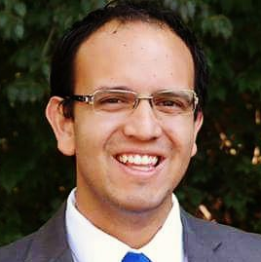







OneMD—Scalable, incorporates internal standards
DePuy Synthes FERD, Enabling Technologies
Ken Fernandez Prada
Senior Eng., Front End R&D
Matt Dressler, PhD
Principal Eng., Front End R&D
Jason Sherman
Principal Eng., Front End R&D
Rick Ditto
Senior Eng., Front End R&D
Johnson & Johnson IT
Boston IC
J&J Adv. Analytics
Jun Chen
Senior Director, IoT
Shawn Ashcraft
Senior Mgr, IT R&D Innovation
Varun Ramdevan
Portfolio Manager
Amer Ghanem, PhD
Lead Data Scientist

Slide 4




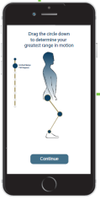



The Opportunity
Personalized medicine requires personalized data through the continuum of care.
DePuy Synthes has disparate enabling technologies (e.g. Radlink, BrainLab) that do not “speak” with one another or store data in a centralized place.
Actitrack

Slide 5

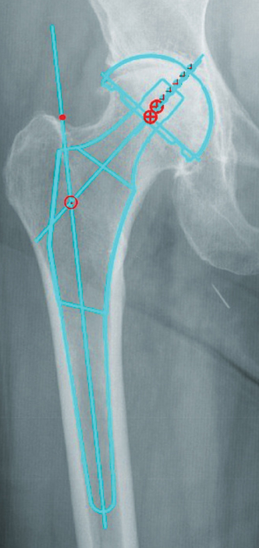
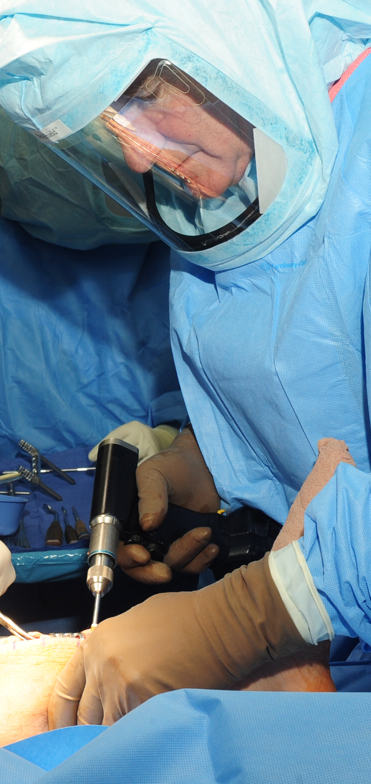







IoT Infrastructure
Predictive Analytics Engine
Pre-op
Intra-op
Post-op
Supply Chain
Smart Tools
(eCP, eST)
Wearables
(Sleep, Steps)
Case Scheduling
Patient Records
(EMR, Vitals)
Patient Surveys
SES IoT Infrastructure

Slide 6




Explore / Integrate
Supply Chain
Real-time field inventory
Billing and replenishing
Transfers
Case scheduling
Potential EMR replacement
Create
Health & Wellness
Earlier education and Engagement
Surgical companion
Actigraphy and patient reported outcomes
HCP Portal
Clinical
Smart instruments
Reduce surgical variability
Predictive analytics
Improve outcomes
Deploy
Confirm

Slide 7

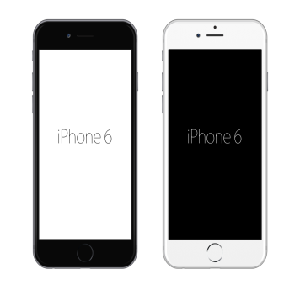

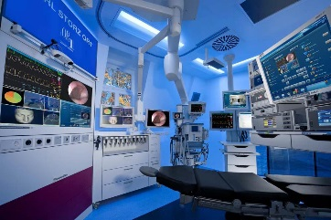


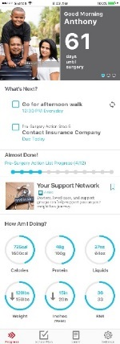
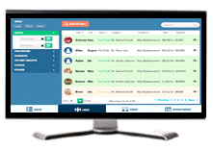
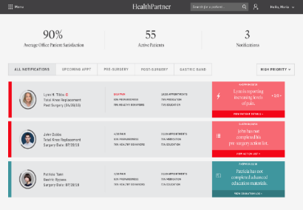
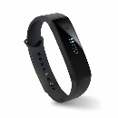
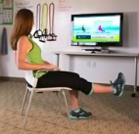



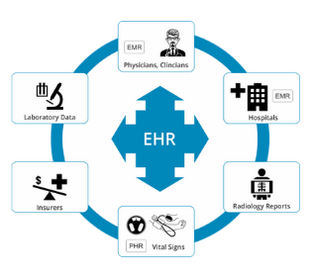



Framework
Our conversation is pushing HealthPartners to envision a broader system…
Facility and Operating Room
Care Portal
Public Web Sites
Education
Segmentation
Connects Patients to Surgeons
Patient Tools
Care Mapping & Coordination
Population Segmentation
Provider Recommendations
Operational Efficiency
Health Economic Outcomes
Clinical Outcomes
Virtual PT
Orthopaedics
Bariatrics
Oncology
Pharma
Surgical Education
Supply Chain
Consumers and
Pre/Post Operative Patients
Integrated Digital Platforms
Data and Insights
Consumer Insights, Segmentation & Modelling
Product, Behavior Science & Advanced Analytics
Cognitive Computing and Clinical Predictive Analytics
:Represents Line of integration
Confidential: For Internal Use Only

Slide 8
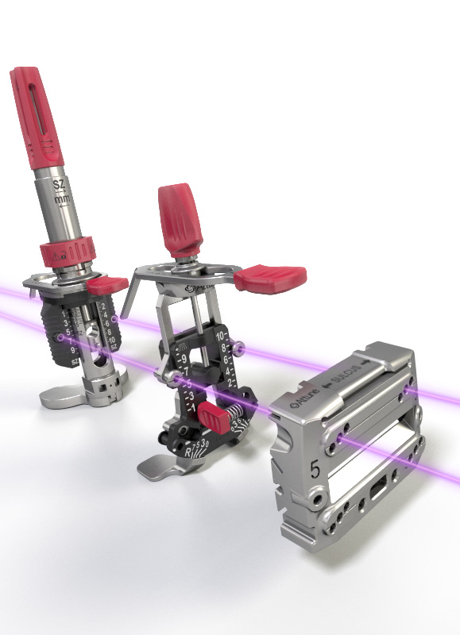
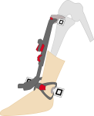
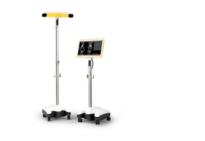
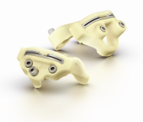
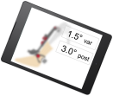

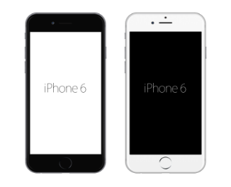
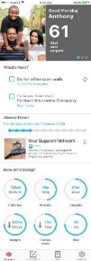


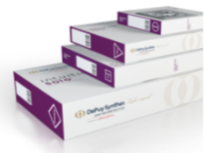


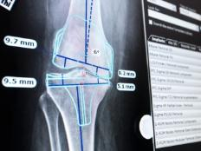

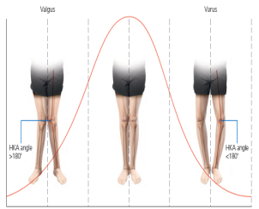



Integrated Digital Platforms
Improve Outcomes & Reduce Costs
Patient Web Sites
Personalized Smart Tools
A solution built on science and insights to deliver personalized care and support behavior change throughout the orthopaedic journey
Patient Tools
Patient Tools
Virtual PT
Virtual PT
Pre-Op Monitoring
Personalized Inventory Delivery
Post-Op Monitoring
Care Portal
Improved Functional Outcomes
& Patient Satisfaction
Consumer Insights, Segmentation & Modelling
Product, Behavior Science & Advanced Analytics
Cognitive Computing and Clinical Predictive Analytics
Personalized Medicine
Device Performance
Efficient Supply Chain
Biomechanical Simulation
Cloud-based Data & Insights

Slide 9
Our Ask…
Value to you
Apply machine learning on TruView data to reduce cost to serve
Augment TruView data (eg pre-op imaging)
Potentially enable managed services and other business models
Contribute to enterprise solution for personalized medicine
Others?
Required Steps
Determine unique case ID within HealthPartners and TruView
Connect to datasets and merge in J&J Enterprise Data Lake
Develop predictive models with J&J Data Science team
Confidential: For Internal Use Only

Slide 10
IoT Infrastructure
Predictive Analytics Engine
Pre-op
Intra-op
Post-op
Supply Chain
Smart Tools
(eCP, eST)
Wearables
(Sleep, Steps)
Case Scheduling
Patient Records
(EMR, Vitals)
Patient Surveys
SES IoT Infrastructure

Slide 11
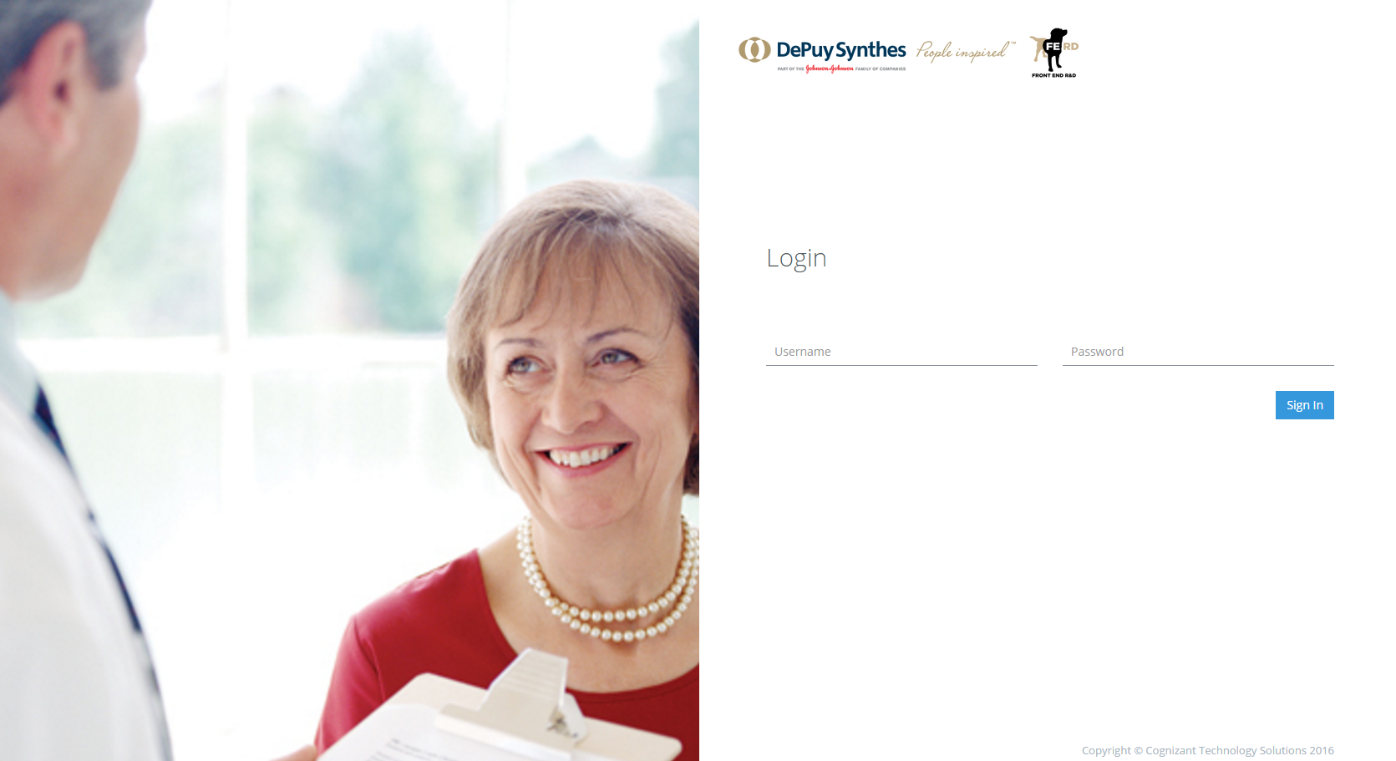
IoT Aggregation and Visualization
http://10.37.163.140/depuy
U/N and P/W: clinician

Slide 12
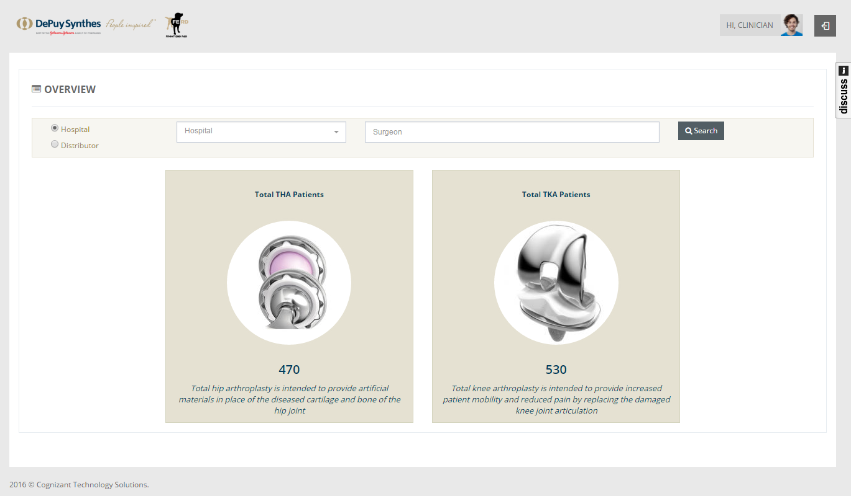
Total Overview

Slide 13
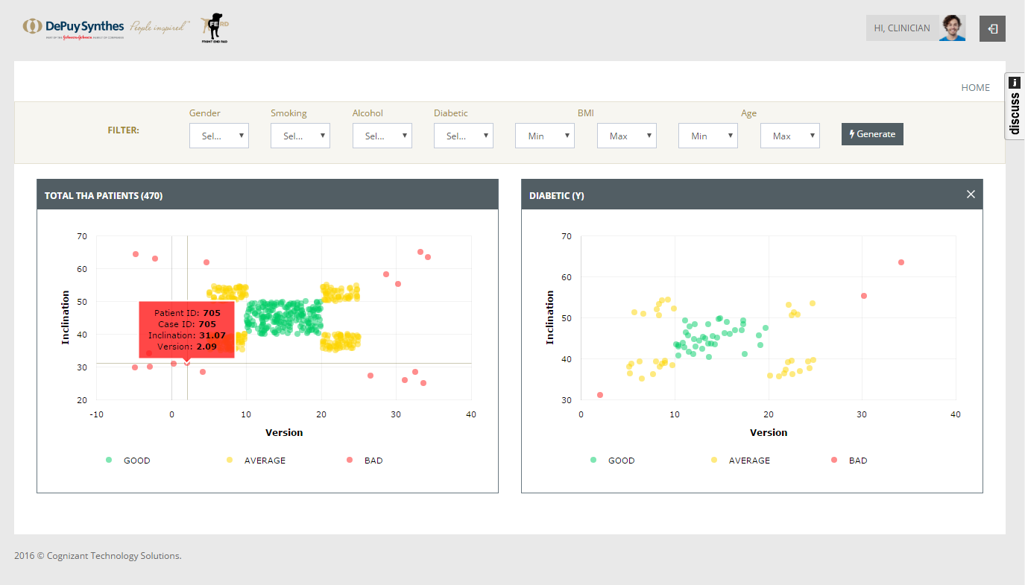
EMR and Intra-op Integration

Slide 14
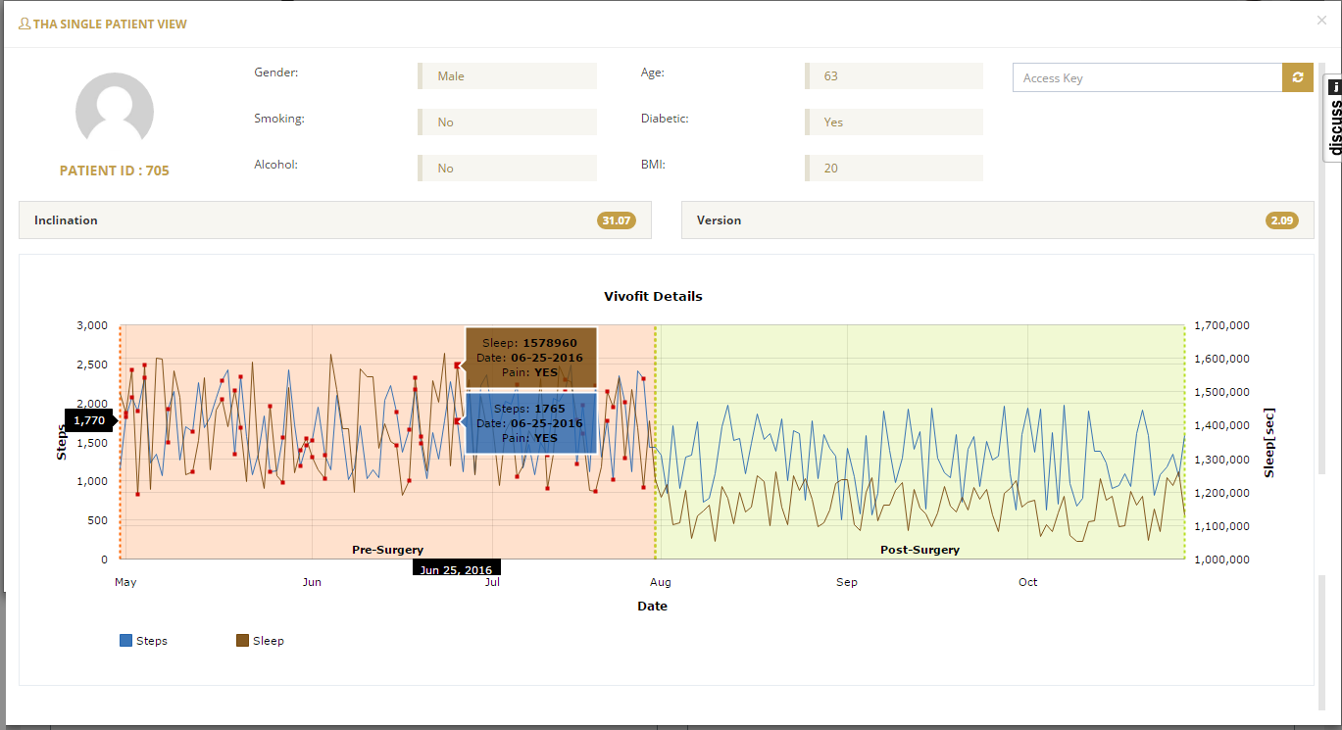
Intra-op, EMR, PRO and Actigraphy Integration

Slide 15
Early machine learning effort
Predictive Analytics Engine
Pre-op
Intra-op
Post-op
Supply Chain
Smart Tools
(eCP, eST)
Wearables
(Sleep, Steps)
Case Scheduling
Patient Records
(EMR, Vitals)
Patient Surveys
SES IoT Infrastructure

Slide 16


Our team supports Health Partners’ relationship with IBM Watson
Our predictive models built with internal clinical data (n=606) are similar to IBM Watson models created with purchased claims data (Explorys, n=11,444).
Predict key outcomes:
Will a patient have a long length of stay (> 4 days)?
Will an adverse event occur?
Will the patient have an early readmission (< 90 days)?
Will the patient have a poor outcome score?

Slide 17
Concept for IoT and Machine Learning
Value to you
Apply machine learning on TruView data to reduce cost to serve
Augment TruView data (eg pre-op imaging)
Potentially enable managed services and other business models
Contribute to enterprise solution for personalized medicine
Others?
Required Steps
Determine unique case ID within HealthPartners and TruView
Connect to datasets and merge in J&J Enterprise Data Lake
Develop predictive models with J&J Data Science team
Confidential: For Internal Use Only

Slide 18
Backup Slides

Slide 19
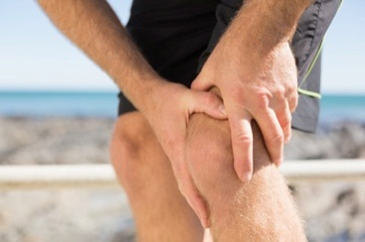


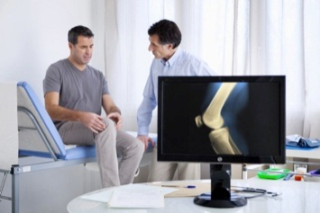




A Solution Built on Science and Insights to Support Behavior Change Throughout the Orthopaedic Journey
Contemplate care
Decide on surgery
Pre-op to post-op
Tailored and personalized insights for similar patients
Earlier patient engagement
Sustained progress every step of the way
Establishes richer, more sustainable support network through digital, social & community
Connects patients to an elite care team, tailored just for them
Connects all patient data – clinical, EMR, social, digital & behavioral – & insights for physicians, hospital systems & payors to drive value
Mission generator guides patients to set achievable goals & action plans
Virtual coach maintains 1:1 relationships & enables effective digital rehabilitation
Adapts care plan throughout the journey to meet patients no matter who & where they are
Improve Outcomes and Reduce Costs
Reduce length of stay
Reduce physical therapy
Reduce re-admission
Decrease complications
Decrease discharges to SNF/IRF
“Ow”
“Wow”
19

Slide 20

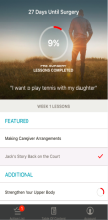
HealthPartner Overview
Patient Solution
Provider Solution
Earlier Education and Engagement
Predicts OA progression, educates consumers on treatment options and engages them through OA journey
Surgical Companion
Guides patients along tailored care path to help prepare for and recover from surgery
HCP Navigation Platform
Enable care coordinators to monitor progress, collect data, adjust plans, and engage patients

Slide 21
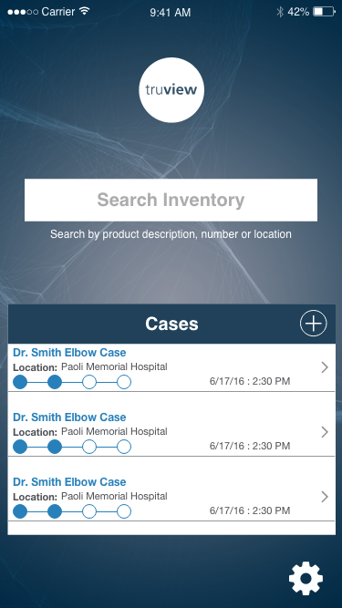
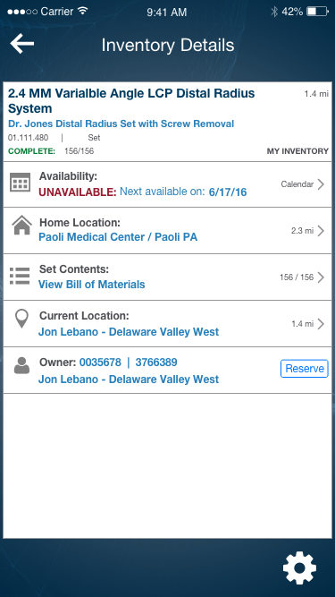
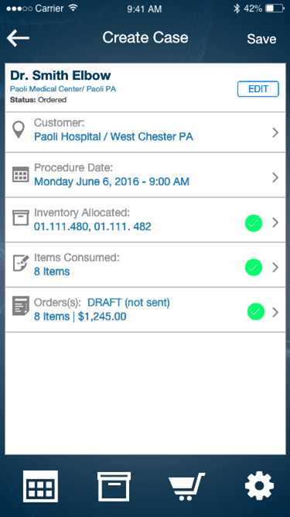
Pre-op Terminals
1
2
Inventory Search
Case Scheduling
Screenshots from “truview” project in Supply Chain

Slide 22
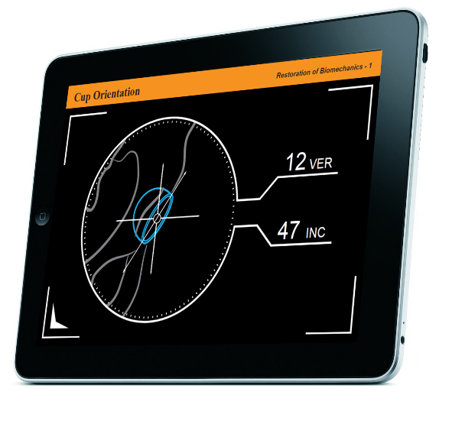
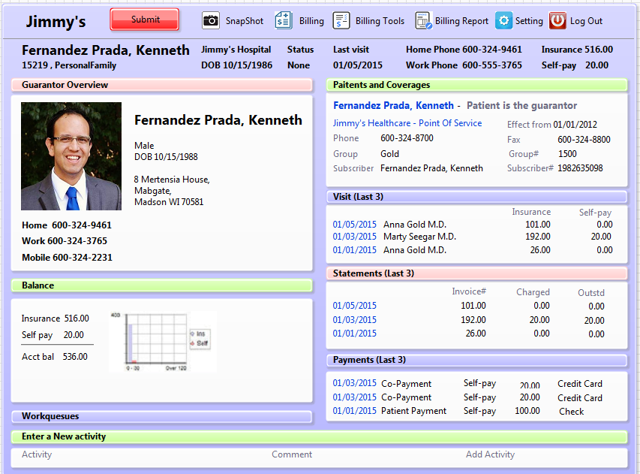
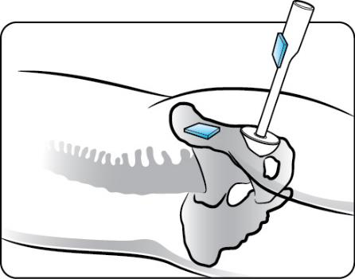
Intra-op Terminals
1
2
eCP GUI
Patient Demographics

Slide 23
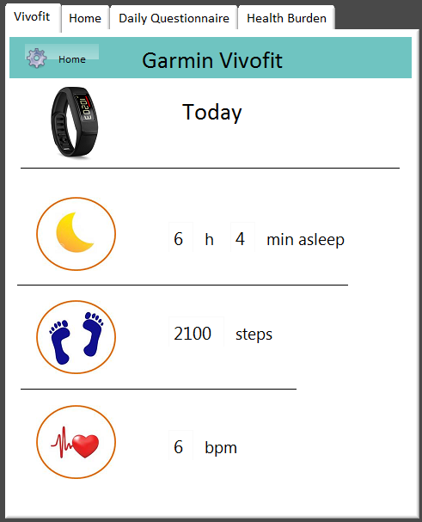

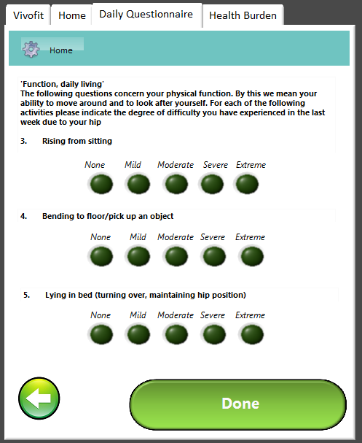
Pre/Post-op Patient Terminals
1
2
3
Activity Tracker
Reminders
Patient Surveys

Slide 24

Choosing the proper machine learning toolkit
Classification
“Patient stratification”
(Naïve Bayes Classifier)
Regression
“Predict a numerical value”
(Artificial Neural Network)
Predict numeric outcomes…
Post-op scores (e.g. OKS, PKIP)
Patient ROM / mobility
Probabilities…
90-day readmission
Long length of stay
Adverse events
Patient journey applications
“If patient loses 10 pounds, her post-op PKIP improves 4 points.”
Pre-op Planning Optimization
Calculate surgical parameters (e.g. implant, patella mgmt) needed to optimize post-op outcome score.
Who should receive surgery?
Based on either J&J offering or payer / provider risk tolerance
High / Med / Low risk for…
90-day readmission
Long length of stay
Low activity / sleep levels post-op
Poor PROMs
Many, many more
Not a medical device
Software as Medical Device (SaMD)

Slide 25
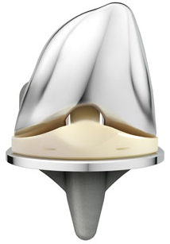
JJMD clinical assets are a great starting point
Patients in Attune studies 10004 & 10008
(n = 2412)
Patients with complete
10004 data
(n = 606)
Potential data for
15-year study
Subset used for this
investigation
Will the patient have a long length of stay (> 3 days)?
Will an adverse event occur?
Will the patient have an early readmission (90-day)?
Will the patient have a poor outcome score?
Can we predict answers to clinical questions?

Slide 26
Summary of ANN Model Performance
 | Model Performance
Model | Overall Accuracy | Precision (PPV) | Recall (Sensitivity)
Long LOS (> 3 days) | 85% | 0.72 | 0.40
Adverse Events | 62% | 0.31 | 0.08
Short-Term Adverse Events (90 Day) | 83% | 0.33 | 0.02
Poor PKIP score (< 70) | 63% | 0.52 | 0.41
* Detailed results available by clicking on model name
** Results from 10004 study only

Slide 27
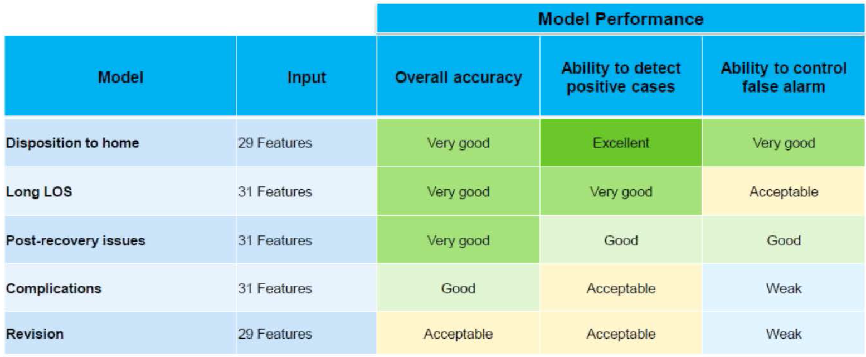
Summary of IBM Watson Model Performance
* IBM Watson Health results using Explorys dataset (n = 11,444)

Slide 28
Feature Extraction: Model Inputs
Collected Pre-op
Measured
Post-op
Demographic characteristics
Age
Clinical characteristics
BMI
Surgical parameters
Device implanted
Pre-op baseline
X-ray data
Gender
Race
Selected comorbidities
Previous treatments
Knee alignment
Primary diagnosis
Hip pain levels
AP alignment angle
Distal femoral angle
Proximal tibial angle
Femoral component flexion
Posterior tibial slope
Incision/approach
Patella management
Cement type
Measured resection or gap balancing
Soft tissue releases
Procedure duration
PKIP scores
Range of motion (flexion and extension)
Patient expectations

Slide 29
Feature Importance for each model
Long LOS (> 3 Days)
Was the patella resurfaced?
Adverse Events
SUI instruments used?
90-Day Adverse Events
Gen Med: DVT
Poor Post-op PKIP Total Score (< 70)
Pre-op PKIP total score
Pre-op extension (flexion contracture)
PS RP implants
No previous surgeries
Pre-op PKIP satisfaction
Primary diagnosis: “Other”
Lateral patella release (Y/N)
Pre-op PKIP stability
Posterior tibial slope
TruMatch used?
Pre-op flexion achieved
Gen Med: cardio
Antibiotic bone cement used?
Primary diagnosis: “posttraumatic arthritis”
Previous treatment: ORIF
Previous treatment: lateral release
Synovectomy during operation
Pre-op pain walking (KSS question)
Previous treatment: meniscus
Gen Med: kidney disease
Gen Med: inflammatory disease
Pre-op PKIP modify
Pre-op PKIP confidence
Previous treatment: lateral release
Gen Med: gastro disease
Primary diagnosis: “Other”
Pre-op KSS patient expectation #3
Measured resection
Pre-op KSS patient satisfaction #5
Procedure duration
No soft tissue releases
BMI
High
Importance
Low
Legend:
Demographic characteristics
Clinical characteristics
Surgical parameters
Pre-op baseline
X-ray data
*Models weren’t great. Approach feature importance with skepticism.
**Based on |abs| of weights. Does not indicate direction of response.

